Slide 1


Social Buzz – Data Analysis

Slide 2


Today's agenda
Project recap
Problem
The Analytics team
Process
Insights
Summary

Slide 3

We at Accenture are undergoing a data analysis process to find important insights on how to grow Social Buzz as a company and make it outgrow its competition.
We with the data we have will determine whether Social Buzz is ready to make an IPO, determine its top 5 content categories and see what other insights about the company we can get from the data we have been given.
Project Recap

Slide 4

Problem
Lack of data synergies
Overload of current and new data being captured daily that needs to be cleaned and analysed for insights
Non-existing/old data models

Slide 5



Chief Technical Architect
Data Scientist
Data Analyst
The Analytics team

Slide 6
Process
1
Looked ay Data, Company Hierarchy and Entity Relationships within the Data provided
2
Data wrangling and cleaning stage
Data modelling and merging, creating synergies and removing duplicates
3
We analysed the data and provided insights
4
Recommendations for Social Buzz
5

Slide 7
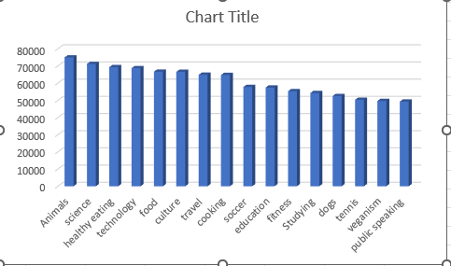
Insights

Slide 8
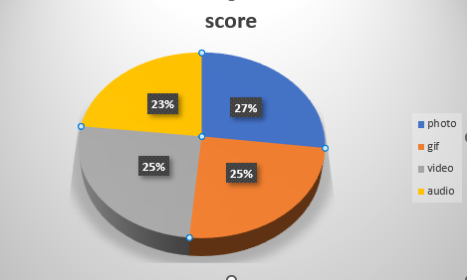

Slide 9
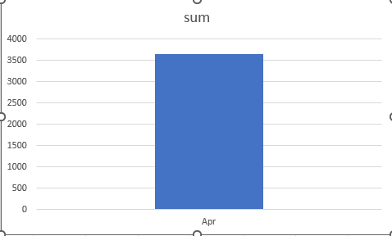

Slide 10


1. The first insight depicts the reactions and their scores. This shows the most engagements on Social Buzz were from the animal category. Social Buzz should probably focus one ensuring to provide more content on this category to increase maximise engagements.
2. Photos have the highest score percentage than the other content categories.
3. April was the month that scored the highest in terms of engagements on Social Buzz for all the years that were provided on the data given.
Summary

Slide 11
Thank you!
ANY QUESTIONS?

